Slide 1
SMART ROAD DIVIDER
(Data mining framework for real-time process/automation data)
IoT Hackathon
Notes:
1

Slide 2

Executive Summary
In order to reduce the traffic congestion we propose our idea of controlling the road divider for an extra lane as per need with the help of IOT.
As per the traffic congestion observed in our daily life through the real-time cameras.
We gather the data collected from the cameras and send them to cloud for analyzing the traffic.
In analysis part, the data will be analyzed using raspberry pi through image processing.
After analyzing, the necessary action is performed whether to push/pop the divider.

Slide 3
The problem with Static Road Dividers is that the number of lanes on either side of the road is fixed.
Since the resources are limited and population as well as number of cars per family is increasing, there is significant increase in number of cars on roads.
This calls for better utilization of existing resources like number of lanes available.
Problem being solved

Slide 4
HARDWARE REQUIRMENT: -
RASPBERRY PI 3 MICRO CONTROLLER
32-GB SD CARD
T COBBLER
SERVO MOTORS
PI CAMERA
SOFTWARE REQUIREMENTS: -
PYTHON
RASPBIAN OPERATING SYSTEM
OPEN CV( IMAGE / OBJECT DETECTION )
IBM WATSON (CLOUD)
Technology Stack

Slide 5
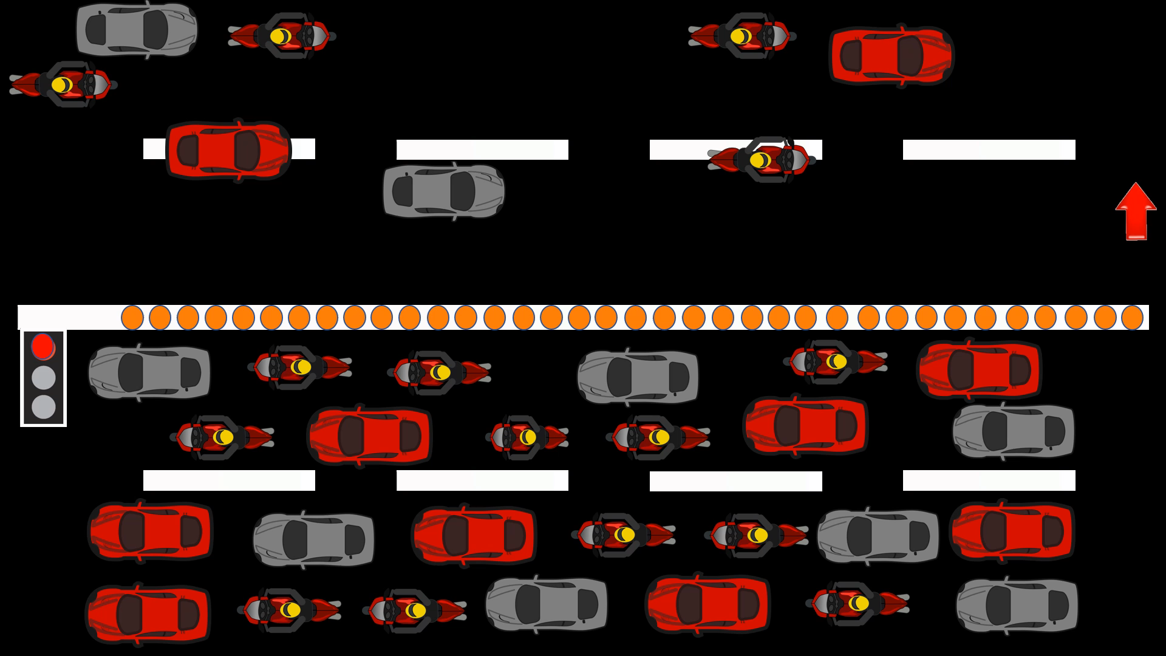
Demo Video/Screenshot

Slide 6
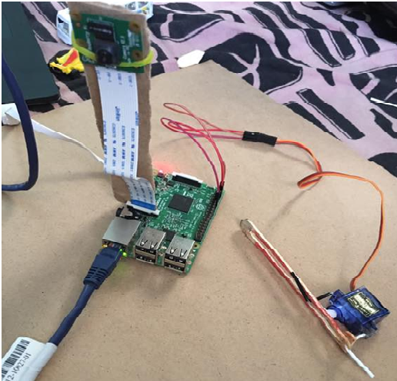
Demo Video/Screenshot

Slide 7
Problems faced during connecting raspberry pi display to laptop .
Problems faced during image /object detection .
Problems faced with programming errors.
Problems faced during making perfect circuit to make dividers push/pop .
Challenges faced

Slide 8
Why This Approach
In this approach , we will eliminate the dependency on manual intervention and manual traffic coordination ,so that we can have a smarter traffic all over the city.
An Automated movable road divider can provide a solution to the above-mentioned problem effectively. This is possible through IOT.
This project is to decrease the time of journey in the peak hours and to avoid traffic congestions and to provide a better and a smarter solution for traffic problems.
Enables ability to analyze and predict traffic faster and more accurately than ever before.
Provides new insight into mechanisms that effect a complex traffic system.
Smarter, more efficient, and More Environmentally Friendly Traffic.

Slide 9


